Slide 1
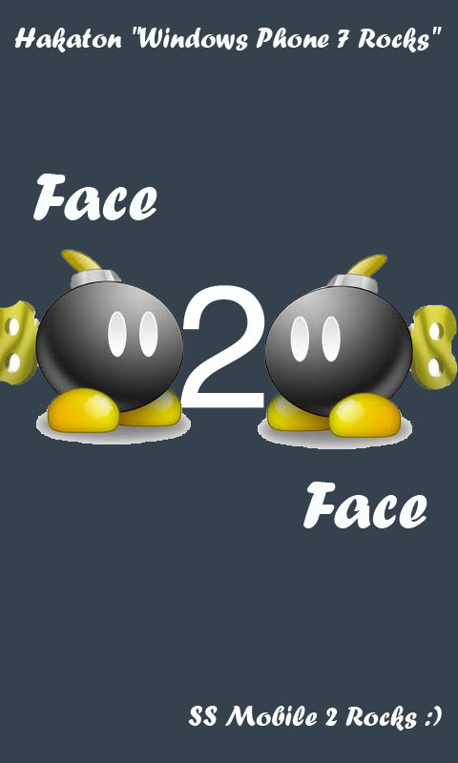

Slide 2
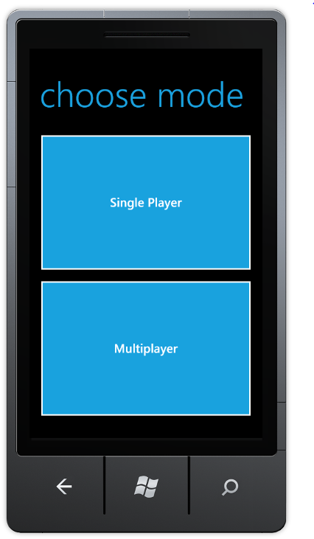

Slide 3
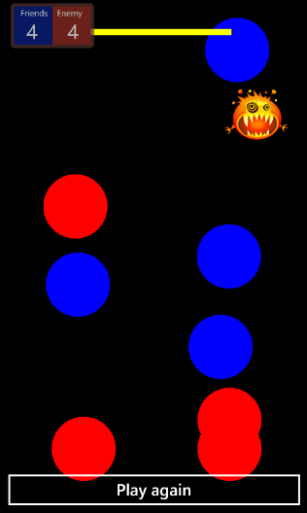
Single Play Mode

Slide 4
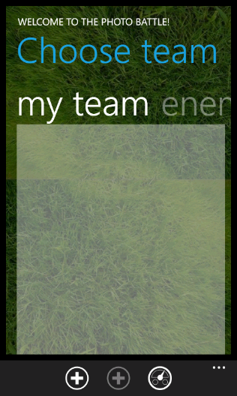
Multiplayer – shot your friends

Slide 5
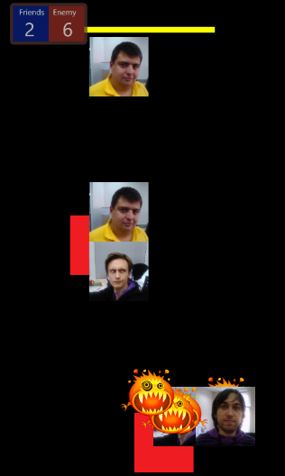
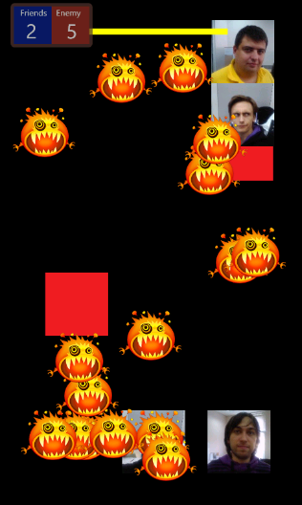
You have two teams – PLAY ☺

Slide 6
Features
Interactivity
Fun
Multiplayer
We don’t know if this is unique idea, but hopefully ! ☺

Slide 7
Tech stuff used…
Silverlight and XNA combined
Phone camera
Image manipulations
Sounds
Connectivity to services (tried UDP)

Slide 8
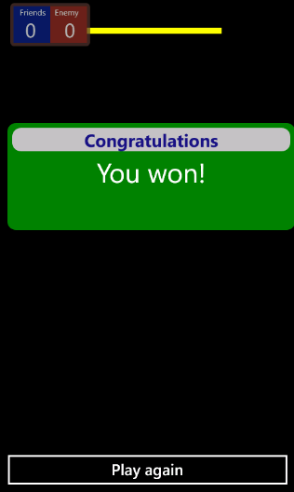
YOU WON! Thank you!

